Slide 1
Outline
Literature
  Anderson, Laurent & Yantis, 2011
  Sandry & Ricker, 2020
Methods
Final Data
  Training Response Time & Accuracy
  Test Discriminability & Criterion

Slide 2
Do Rewarded-Associated Stimulus Features Enhance Memory of Items in Other Contexts
Anderson et al., (2011) found reward history induces attention capture of colored items long after training
  Effects persists across different tasks (Mine & Saiki, 2015) and in counterproductive situations (Le Pelley et al., 2014)
Selective attention is critical for memory encoding (Chun & Turk-Browne, 2007)
Sandry & Ricker (2020) suggests participants can flexibly orient attention towards rewarded items presented in a list format

Slide 3
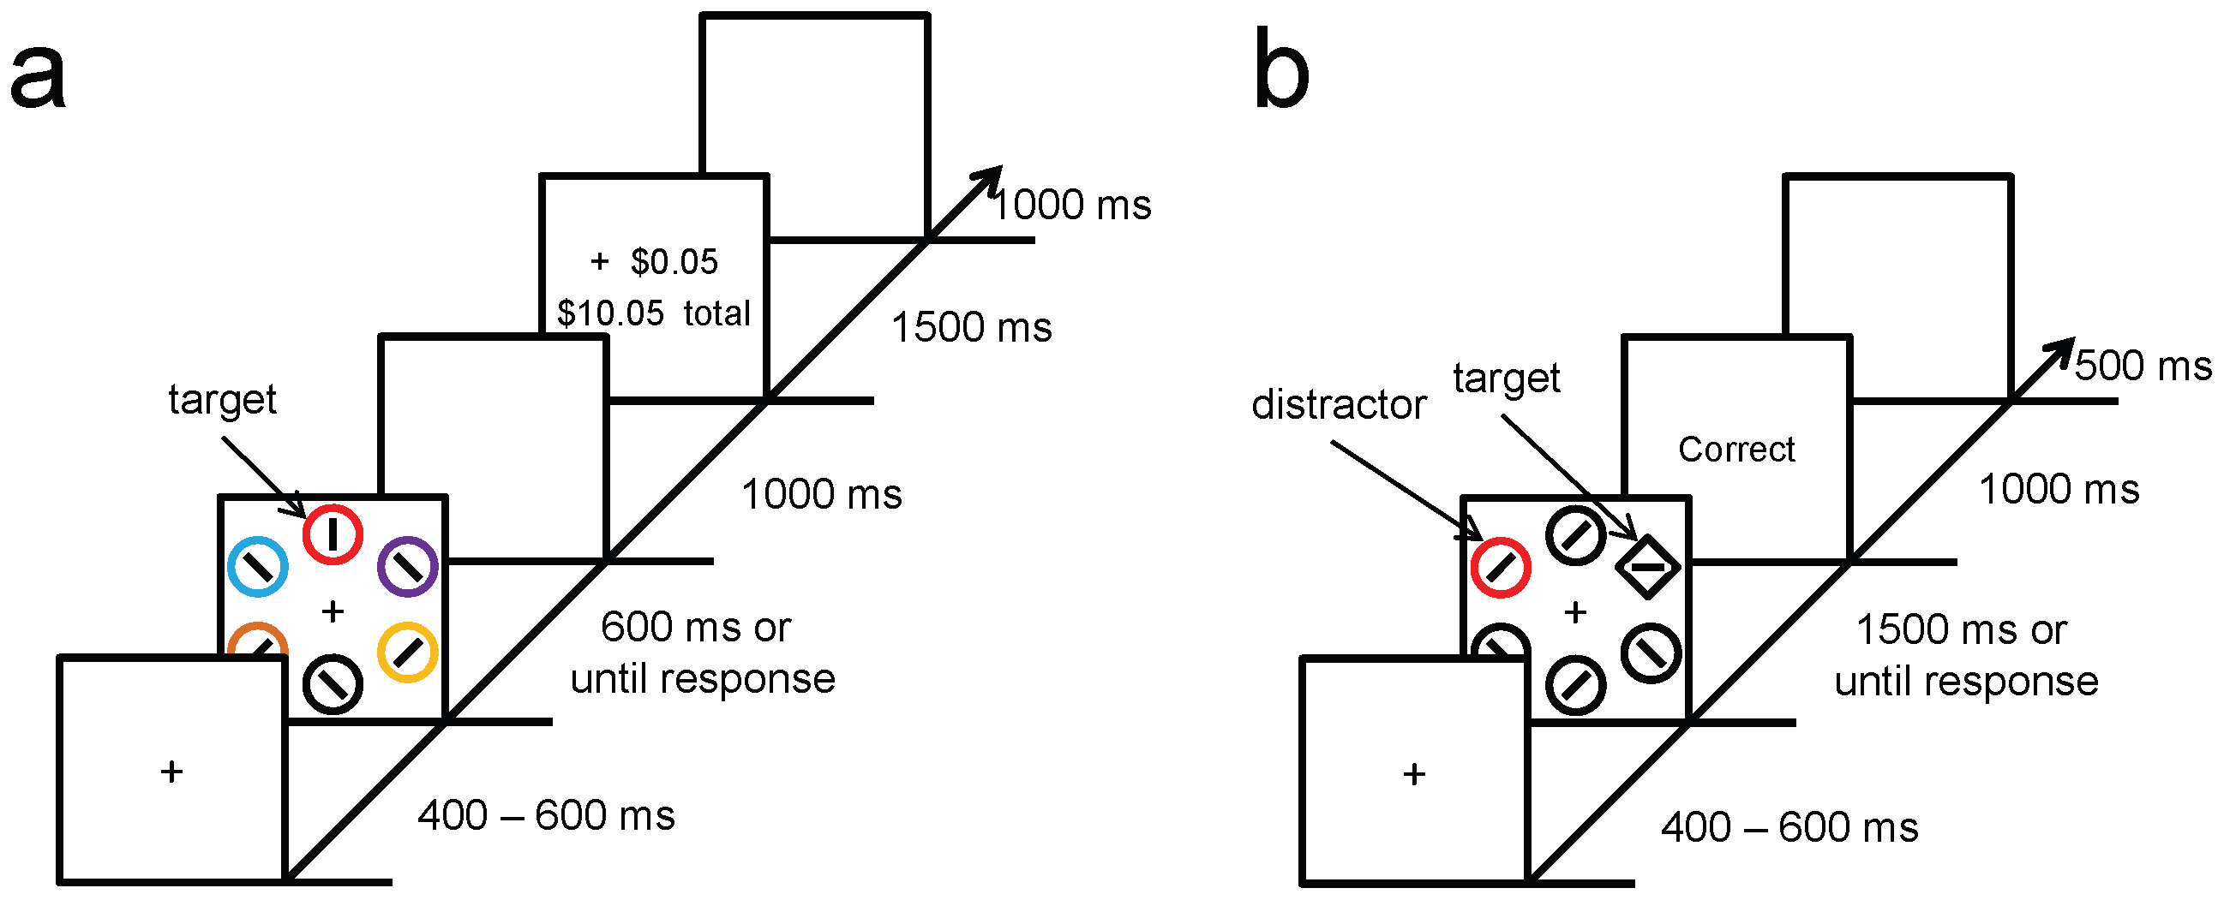
Training (a) and Test (b) Phase
Learned value magnifies salience-based attentional capture
Anderson et al., 2011

Slide 4
Training Phase
Participants identified the orientation of a line contained within red or green circle
High Reward Targets (Red)
  80%: 5¢ 20% 1¢
Low Reward Targets (Green)
  80%: 1¢ 20% 5¢
Anderson et al., 2011

Slide 5
Test Phase
Participants identified orientation of line contained within shape singleton (square)
One distractor was colored in either high-value (red) or low-value (green) color
Color was not relevant to task
Anderson et al., 2011

Slide 6
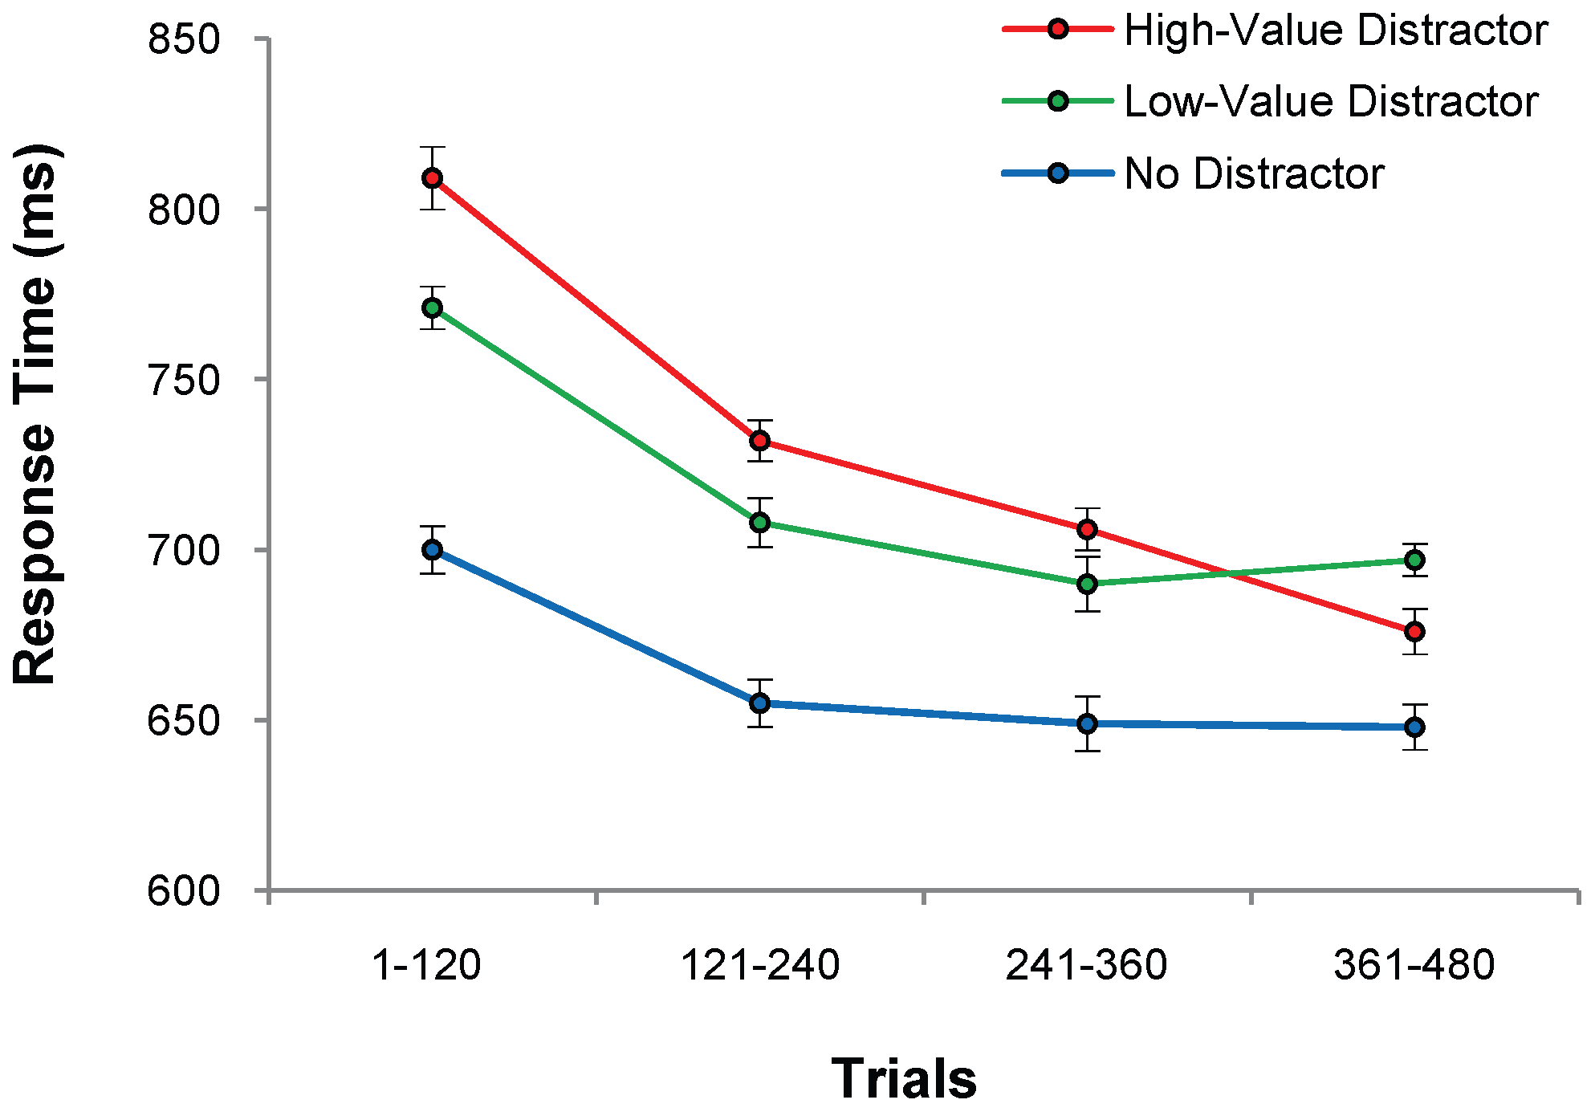
Test Phase:
Higher RT for Previously Rewarded Distractors
High-Value: 728 (3.8)
Low-Value: 710 (3.9)
No Distractor: 655 (5.5)
n = 18
Anderson et al., 2011

Slide 7
Summary so Far
Reward-associated stimulus features influence attentional capture automatically and independently of physical salience or prior selection history
Since attention is critical for memory, can value-driven attentional capture impact memory in other irrelevant contexts?

Slide 8
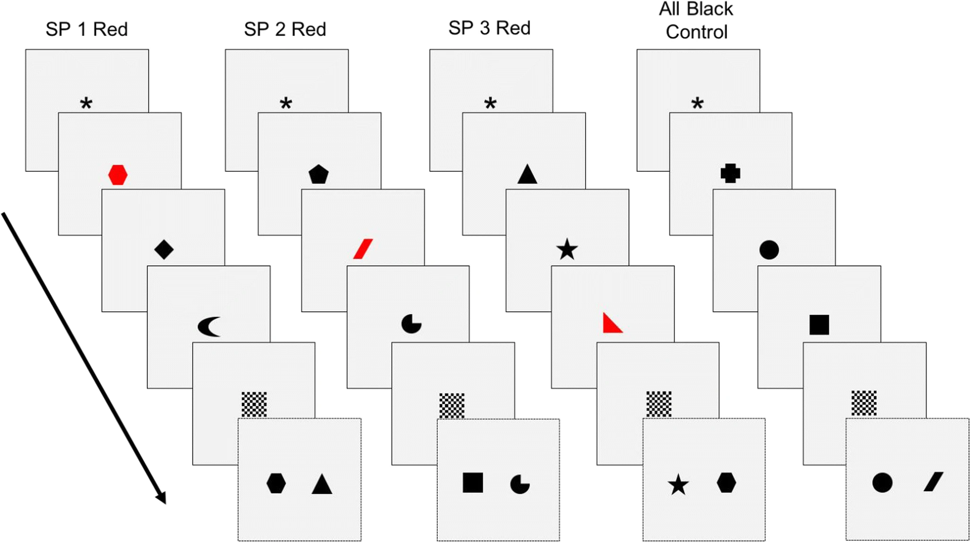
Recognition Task
Each item shown for 0.5s
Black = 3 pts
Red = 25 pts
High-reward vs. Equal-reward
Prioritization within visual working memory reflects a flexible focus of attention
Sandry & Ricker, 2020

Slide 9
Recognition Task
Directions
Characters
Խ Կ Ջ
Sandry & Ricker, 2020

Slide 10
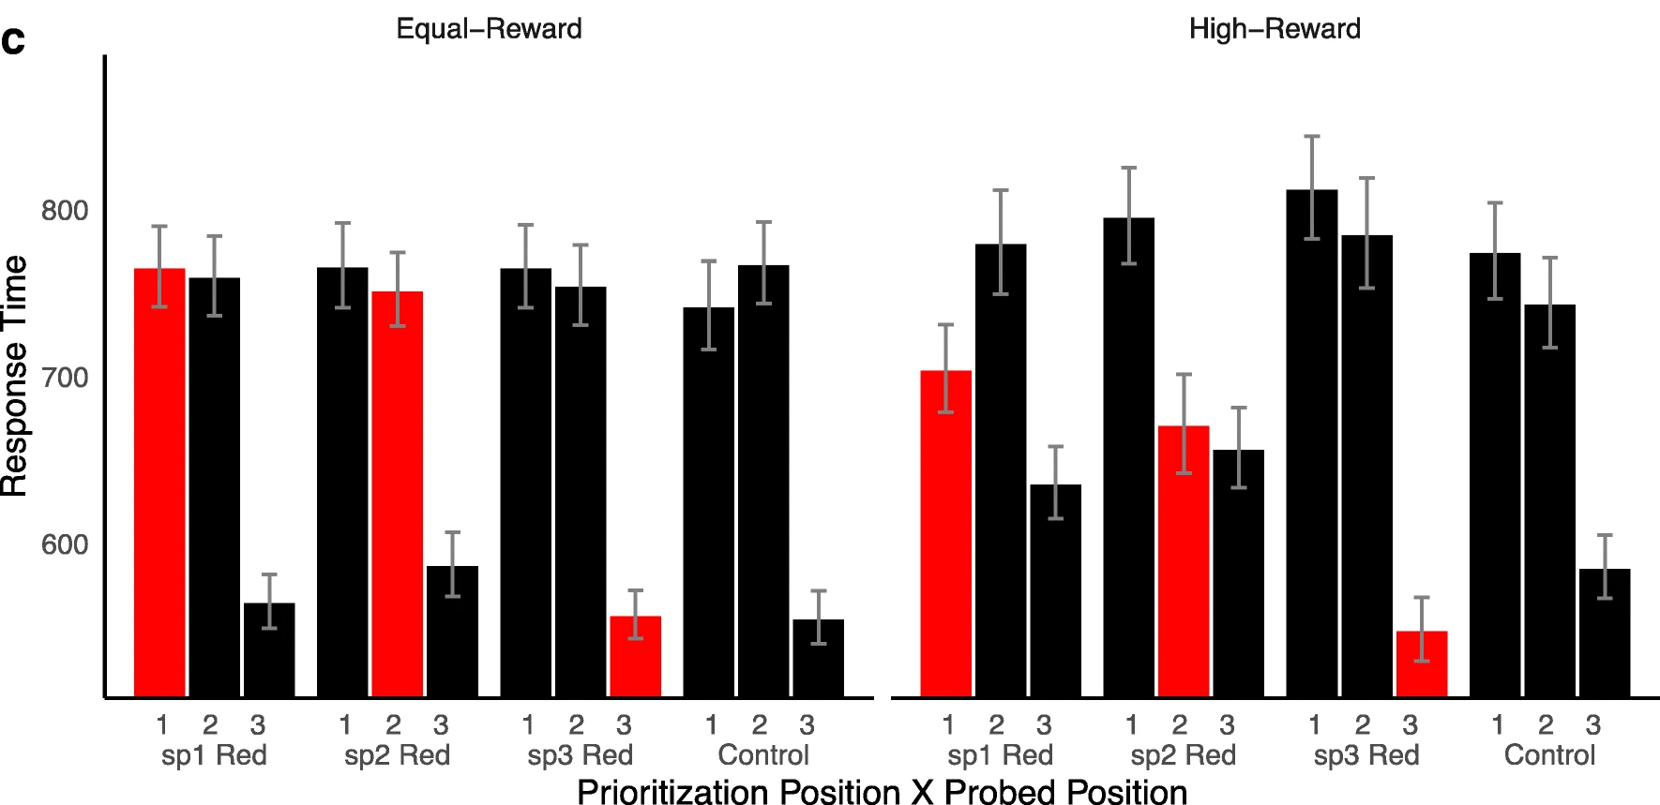
Description of Results

Slide 11
Description of Results
A S D : A
1st item
2nd item
3rd item
Test item (old)

Slide 12
Description of Results
A S D : G
1st item
2nd item
3rd item
Test item (new)

Slide 13
A S D : A

Slide 14
A S D : A

Slide 15
A S D : S

Slide 16
A S D : D

Slide 17
A S D : A

Slide 18
A S D : A

Slide 19
A S D : D

Slide 20
A S D : A

Slide 21
A S D : A

Slide 22
A S D : S

Slide 23
A S D : D

Slide 24
A S D

Slide 25
A S D

Slide 26
Response Time

Slide 27
Response Time

Slide 28
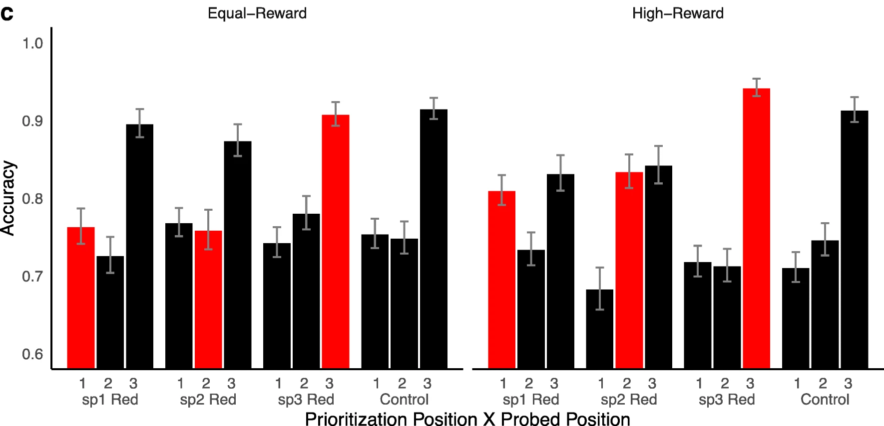
Accuracy

Slide 29
Summary so Far
Reward-associated stimulus features influence attentional capture automatically and independently of physical salience or prior selection history
Attention can be flexibly allocated to maintain memory of rewarded stimuli with some resource trade-offs
Sandry & Ricker’s study does not show if the attentional effects of rewarded stimuli automatically transfer over to a memory task
The use of 2AFC prevents discriminability and criterion analyses

Slide 30
The Current Study

Slide 31
Training Phase
200 training trials
High Reward Targets (Red)
  80%: 10 pts 20%: 2 pts
Low Reward Targets (Green)
  80%: 2 pts 20%: 10 pts

Slide 32
Test Phase
200 Old/New trials
90 Characters from Brussels Artificial Character Sets
Black, red, and green characters
No rewards in-between trials
T Y P : R
New Trial
V B N : B
Old Trial

Slide 33
Participant Information
70 participants recruited online through SONA (2 excluded)
26 did not report having noticed the reward-color associations
42 did report the reward-color association

Slide 34
Training Phase
Accuracy and Response Time

Slide 35
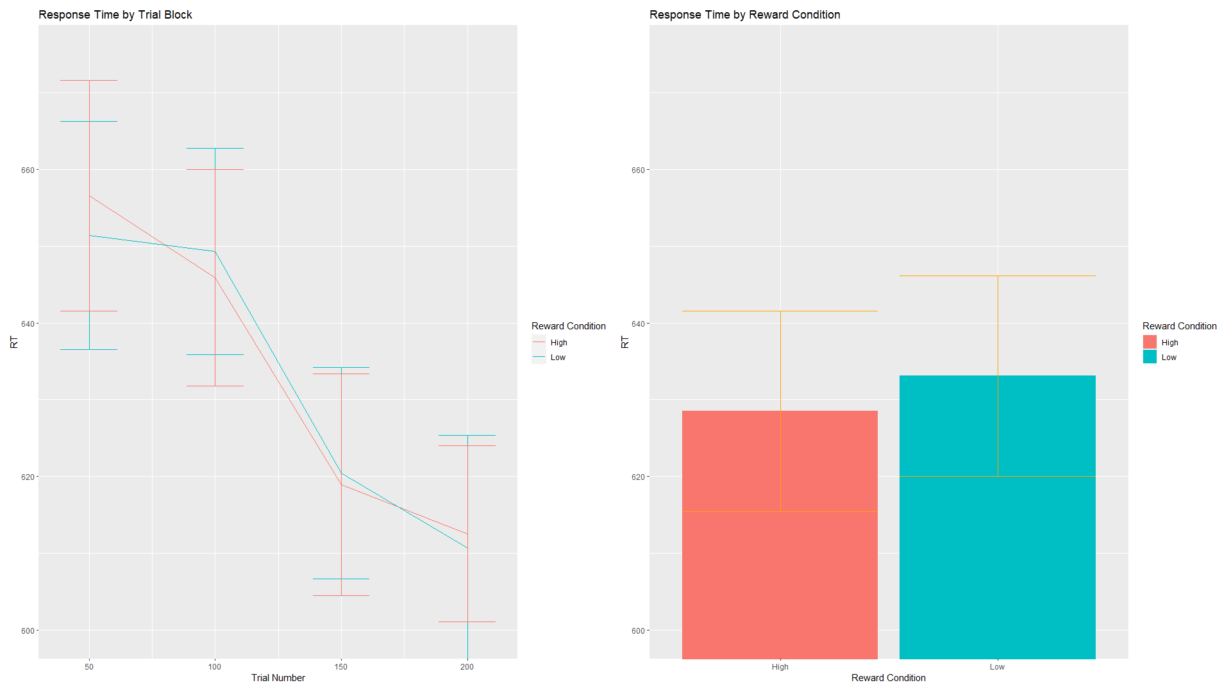

Slide 36
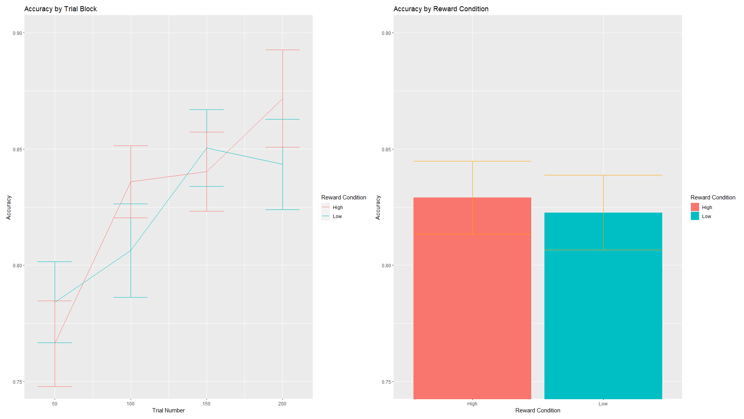

Slide 37
Test Phase
Collapsed d-prime Analysis

Slide 38
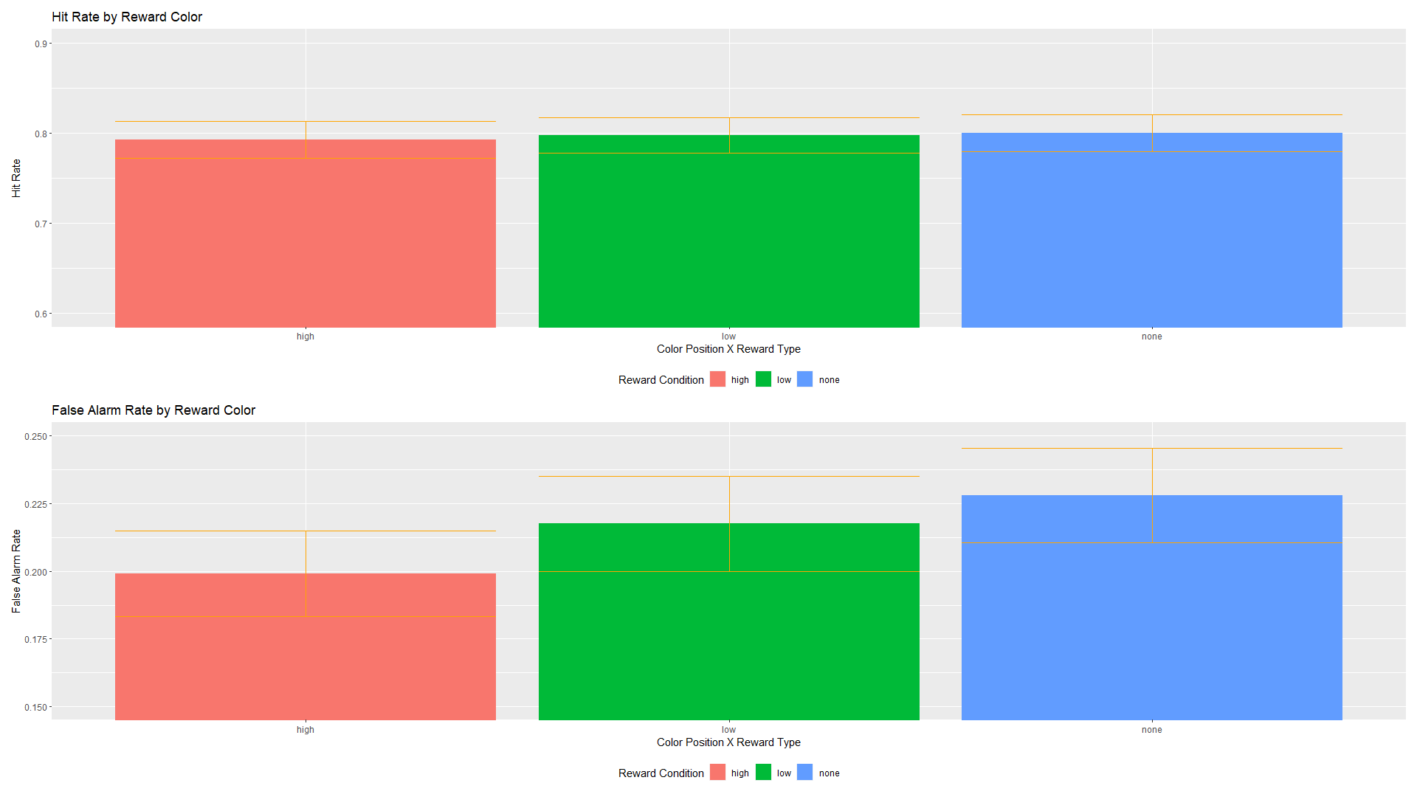

Slide 39
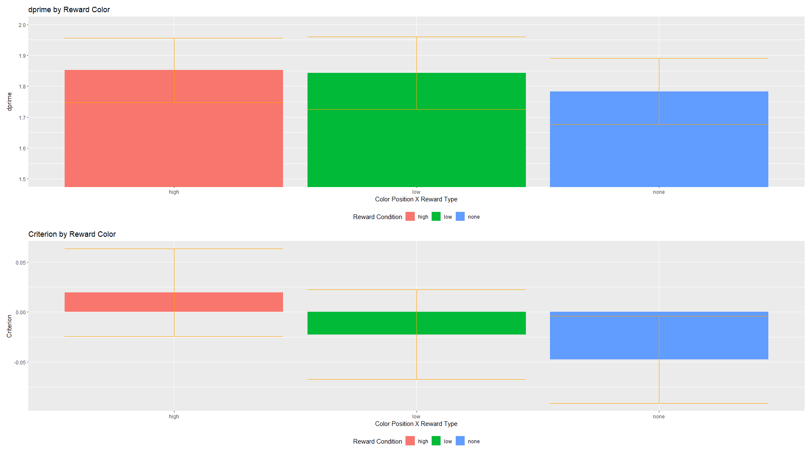

Slide 40
Test Phase
Uncollapsed d-prime Analysis

Slide 41
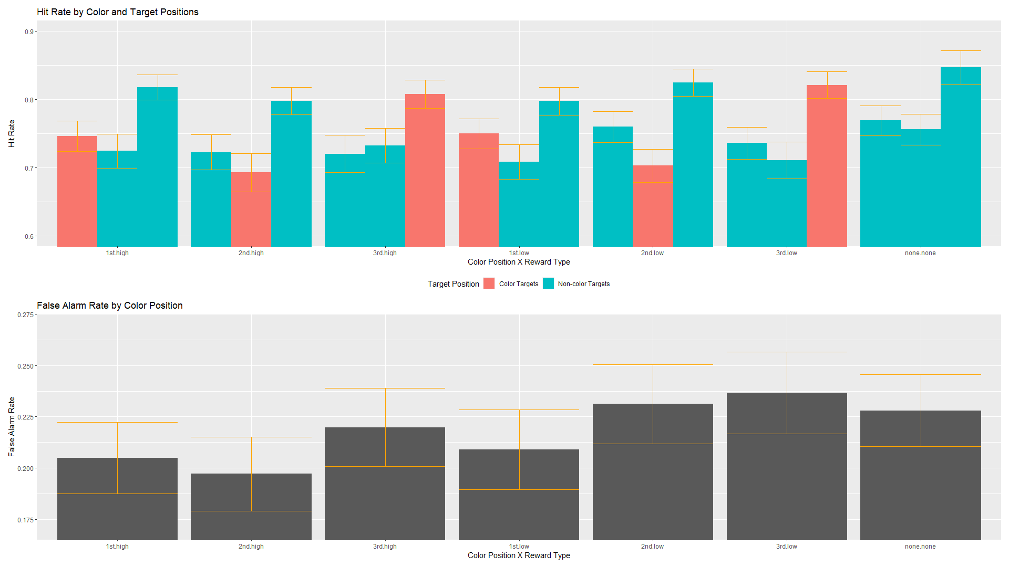

Slide 45
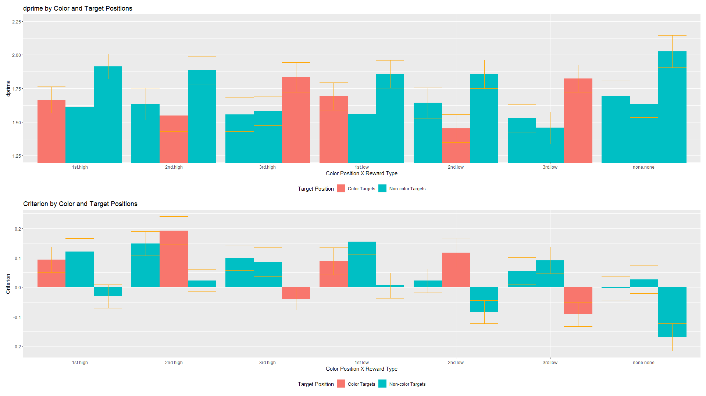

Slide 48
Test Phase
Response Time

Slide 49
